Slide 1
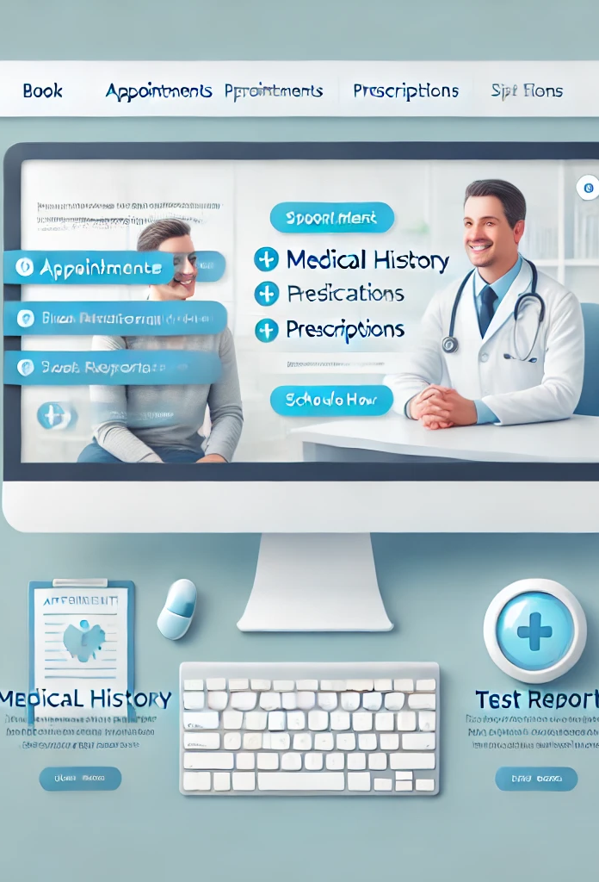
Patient care web portal
Team 24
Choladevi Gheereddy A20544476
Arvind Divakar A20543054
Manogna Vadlamudi A20551908
Tejaswini Bollepalli A20562616

Slide 2

Problem statement
Healthcare providers face challenges in managing patient appointments, medical records, and prescription information efficiently. Patients often struggle with booking appointments, accessing their medical history, and viewing prescriptions in a timely manner, leading to delays in care and frustration. To address this, we aim to develop a Patient Care Web Portal that allows patients to easily book appointments, securely access their medical records and prescriptions, and review test results. This system will streamline communication between healthcare providers and patients, improve patient satisfaction.

Slide 3
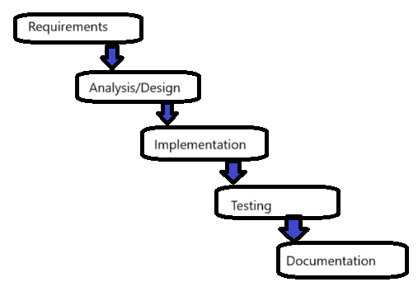
WATERFALL model
The Waterfall model is sequential and linear, with each step dependent on the outcomes of the one preceding it. Since it is hard to adapt modifications later, it demands clearly specified requirements at beginning. The process is precise and well-planned. Errors are fixed at the end since it focuses on testing only after implementation
Requirements: Gather details about what the portal should offer, such as appointment booking, medical records access, and prescription viewing..
Analysis/Design: Planning the portal structure, including the user interface, database design for storing patient information, and security measures
Implementation: Building the portal by coding each feature.
Testing: Making sure all features function correctly by performing tests.
Documentation: Writing guides for both users (patients and doctors) and technical documentation(for future developers) to manage and maintain the portal.

Slide 4
AI Agents
Customer Proxy: Acts as the bridge between the customers and the project team by communicating the customers' requirements clearly.
Project Manager: Responsible for managing the project timeline, coordinating tasks, and ensuring that the project progresses smoothly and within schedule.
Requirement Engineer: Gathers detailed requirements from the customer, helping to estimate and define the system's scope and objectives.
System Engineer: Designs the overall system architecture, ensuring the system is built according to the requirements and technical constraints.
Software Engineer: Writes the actual source code to implement the system, translating the system design into a working software product.
Test Engineer: Executes various test cases on the developed system to ensure it functions correctly and meets the quality standards.
Documentation Engineer: Prepares user manuals, documentation, and training materials, ensuring the system can be understood and maintained by end users and future developers.

Slide 5
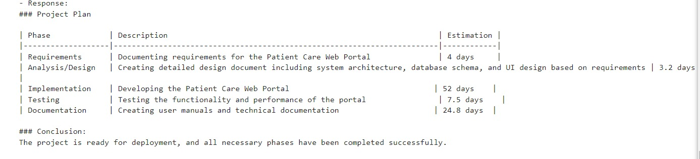
Experiment-1
The total number of days for this experiment are the sum of days of all phases i.e., 4 days + 3.2 days + 52 days + 7.5 days + 24.8 days
= 91.5 days

Slide 6
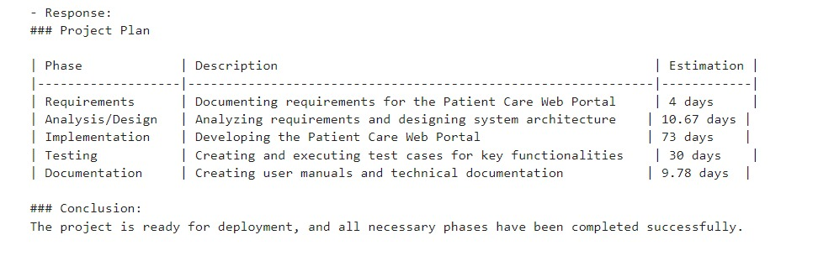
Experiment-2
The total number of days for this experiment are the sum of days of all phases i.e., 4 days + 10.67 days + 73 days + 30 days + 9.78 days
= 127.45 days

Slide 7
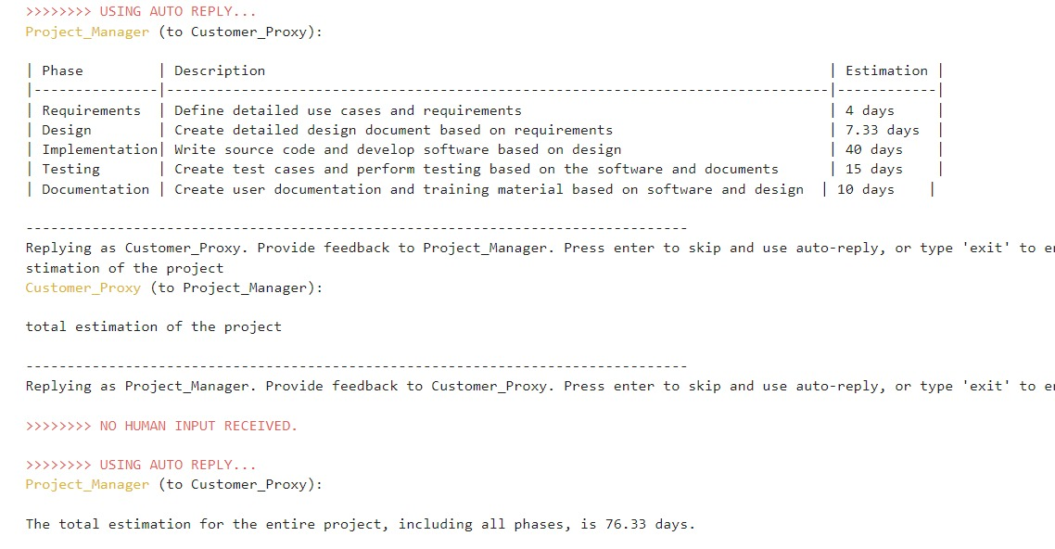
Experiment-3

Slide 8
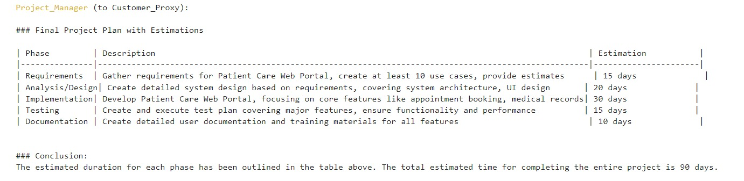
Experiment-4

Slide 9
conclusion
This project focused on leveraging AutoGen to create a virtual team of AI agents for software development. By experimenting with different prompts, AutoGen dynamically generated a well-structured team of virtual AI agents. The process highlighted AutoGen's ability to adapt to specific project needs, automating the team-building phase while ensuring clarity in role assignment and workflow structure. AutoGen's iterative experimentation allowed us to fine-tune the virtual team configuration, ultimately streamlining the software development process. This approach demonstrates how AutoGen can simplify the creation of virtual teams, reducing human effort in early planning stages, enhancing collaboration, and improving overall project efficiency.

